Slide 1

A synodal journey to be continued
Diving in the Final Document of the Synod on Synodality
WUCWO, One step forward on women’s synodal journey
From Reflection to Action, webinar February 24th 2025
Sr Nathalie Becquart, xmcj, Under-Secretary
to the General Secretariat for the Synod

Slide 2
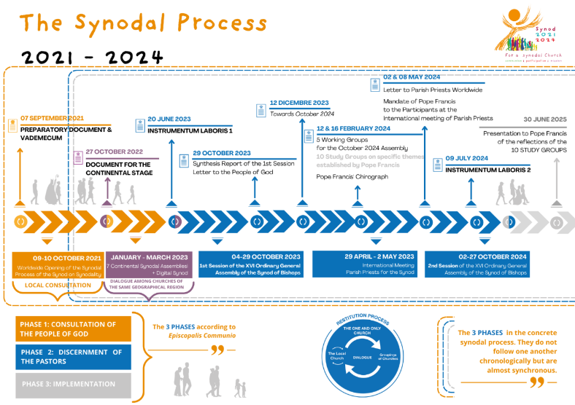
Notes:
The implementation phase :a new important step
FD 9. The synodal process does not conclude with the end of the current Assembly of the Synod of Bishops but also includes the implementation phase. As members of the Assembly and as synodal missionaries within the communities from which we come, we feel it is our responsibility to promote this process. The local Churches are asked to continue their daily journey with a synodal methodology of consultation and discernment, identifying concrete ways and formation pathways to bring about a tangible synodal conversion in the various ecclesial contexts (parishes, Institutes of consecrated life and Societies of apostolic life, movements of the faithful, dioceses, Episcopal Conferences, groupings of Churches, etc.).

Slide 3
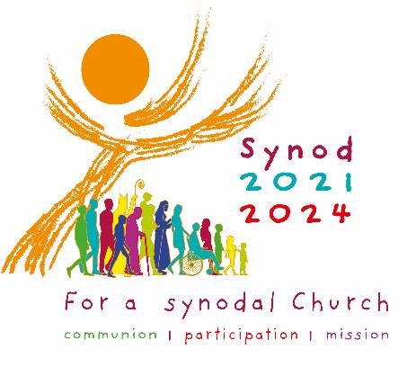

Starter : What is already your main take away from the synod?
1’ in silence,
write in the chat
Notes:
Statistics on sisters participation in each synod commission
Among 54 women, 25 Sisters 5 UISG – 14 from continents
Sisters majority of facilitators
President Delegate : One sister + consecrated woman
Rev.da Suora Maria de los Dolores PALENCIA GÓMEZ, C.S.J. (Messico)
­ Sig.a Momoko NISHIMURA, S.E.M.D. (Giappone)

Slide 4
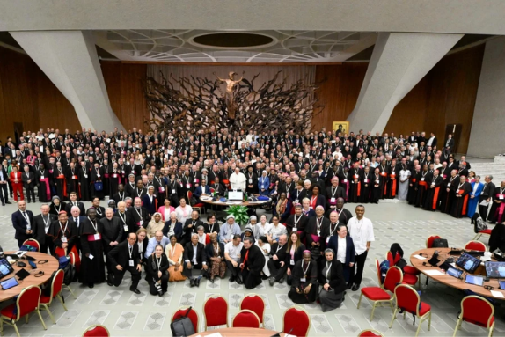

A synod to retrieve synodality as a constitutive dimension of the Church
as a way forward to be a missionary Church to serve the common good
Notes:
The experience of synodality as the way forward : Synodality : the way to be church today
Synodality as the way to answer the cries of the power and to bear more fruits in the mission
Synodality as Prophetic in Today’s World
47. Practised with humility, the synodal style enables the Church to be a prophetic voice in today’s world. “A synodal Church is like a standard lifted up among the nations (cf. Is 11:12)” (Francis, Address for the Commemoration of the 50th Anniversary of the Institution of the Synod of Bishops, 17 October 2015). We live in an age marked by ever-increasing inequalities; growing disillusionment with traditional models of governance, disenchantment with the functioning of democracy, increasing autocratic and dictatorial tendencies and the predominance of the market model without regard for the vulnerability of people and of creation. The temptation can be to resolve conflicts by force rather than by dialogue. Authentic practices of synodality enable Christians to be a critical and prophetic voice over against the prevailing culture. In this way, we can offer a distinctive contribution to the search for answers to many challenges faced by our contemporary societies in building the common good.
How to be a synodal church in mission?
* The synodal approach emerges as a prophetic voice in today's world, offering an alternative to current challenges of inequality, democratic decline, and authoritarian tendencies
* It provides a practical model that balances community and individual needs, countering both extreme individualism and excessive communitarianism while promoting dialogue over force
* Through its emphasis on listening to all voices (especially marginalized ones) and focusing on relationships, synodality aligns with integral ecology and offers concrete solutions for contemporary societal challenges

Slide 5
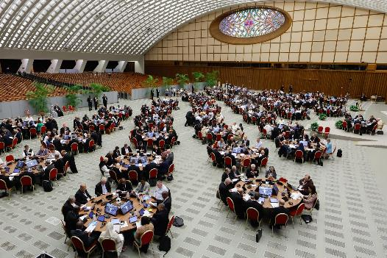
Becoming a synodal Church : a call of God
« A path of spiritual renewal and structural reform for mission” (FD28)
At the heart of the synodal dynamic is the centrality of baptism which binds us together as members of Christ's Body: "There is nothing higher than this baptismal dignity" (21)
Notes:
21. The synodal journey of the Church led us to rediscover the root of the varieties of charisms, vocations and ministries: “we were all baptized into one body […] and we were all made to drink of one Spirit.” (1 Cor 12:13). Baptism is the foundation of Christian life. This is because it introduces everyone to the greatest gift, which is to be children of God, that is, to share in Jesus’ relationship to the Father in the Spirit. There is nothing higher than this baptismal dignity, equally bestowed upon each person, through which we are invited to clothe ourselves with Christ and be grafted onto Him like branches of the one vine. The name “Christian”, which we have the honour of being called, contains the grace that is the basis of our life and enables us to walk together as brothers and sisters.

Slide 6
A definition of synodality
“Synodality is the walking together of Christians with Christ and towards God’s Kingdom, in union with all humanity. Orientated towards mission, synodality involves gathering at all levels of the Church for mutual listening, dialogue, and community discernment. It also involves reaching consensus as an expression of Christ rendering Himself present, He who is alive in the Spirit. Furthermore, it consists in reaching decisions according to differentiated co-responsibilities. Along these lines, we can understand better what it means to say that synodality is a constitutive dimension of the Church (cf. ITC 1).
In simple and concise terms, synodality is a path of spiritual renewal and structural reform that enables the Church to be more participatory and missionary so that it can walk with every man and woman, radiating the light of Christ.” (FD §28).
Notes:
A relational anthropology
Convergences between developmental science/neurosciences/ and Christian anthropology
Understanding based on reciprocity, humans are embodied, holistic, relational and non-reductible organisms
Human being are created men and women at the image of God, with a vocation for communion
human beings are fundamentally relational
Human beings are made for love and friendships, for relationships of mutuality
Human beings need to be seen holistically as an embodiment spiritual thoughtful being
Human beings are vulnerable and fragile, imperfect and incomplete and imperfect → they need the others
Human beings are interdependent and interconnected
Human beings flourished by participating to network of giving and receiving care
Human beings are deeply interconnected with the rest of creation
“becoming one’s best self with and for others, and with a higher purpose”
Human culture is dynamic
EG “ we are all part of a journeying community”
The model of a pluriform unity

Slide 7

A Final Document to be received and implemented from a missionary perspective
"Now the journey continues in the local Churches and their groupings, appropriating the Final Document which was voted on and approved by the Assembly in all its parts on October 26. I too approved it and, by signing it, joined the "we" of the Assembly which, through the Final Document, addresses the holy faithful People of God.
Recognizing the value of the synodal journey accomplished, I now entrust to the entire Church the orientations contained in the Final Document as a way of giving back what has matured over these years of listening and discernment, and as an authoritative reference for the life and mission of the Church.“
Pope Francis, "Address for the Conclusion of the XVI Ordinary General Assembly of the Synod of Bishops", October 28, 2024, https://www.synod.va/en/news/final-document-of-the-xvi-assembly.html

Slide 8
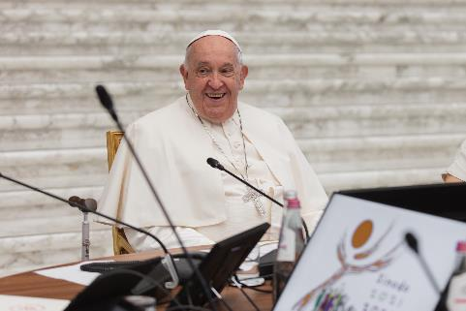
The document's magisterial status :
It is part of the ordinary Magisterium of the Successor of Peter.
It must be accepted as authoritative for the life and mission of the Church.
It is part of a new way of exercising authentic teaching.
« The Final Document is part of the ordinary Magisterium of the Successor of Peter (cf. EC 18 § 1; CCC 892), and as such, I ask that it be welcomed and received. It represents a form of exercise of the authentic teaching of the Bishop of Rome that has some novel features but which, in fact, corresponds to what I had the opportunity to point out on 17 October 2015, when I affirmed that synodality is the appropriate interpretative framework for understanding hierarchical ministry.
Notes:
The Document on which we have voted is a gift three times over.
1. First of all, it is a gift for me, the Bishop of Rome. When I convoked the Church of God in Synod, I was aware that I needed you, the Bishops and the witnesses of the synodal path. Thank you!
I often remind myself, and to you, that the Bishop of Rome, too, needs to practise listening; in fact, he wants to do it, in order to respond to the Word, which tells him every day: “Strengthen your brothers and sisters…. Feed my lambs”.
Accompanying note by the Holy Father Francis to the Final Document
https://www.osservatoreromano.va/fr/news/2024-11/fra-048/note-d-accompagnement-du-pape-francois-au-document-final-de-la-x.html

Slide 9

Conversion as the guiding thread of the FD
" synodality, a constitutive dimension of the Church" (§12)
« requires repentance and conversion” (§6).
At the heart of the synodal dynamic is the centrality of baptism** which binds us together as members of Christ's Body: "There is nothing higher than this baptismal dignity" (§22).
The goal of synodal conversion: a spiritual and ecclesial renewal to bear more fruit in the mission serving the men and women of our time.
Structure of the Final Document**
  Introduction
  Part I - The heart of synodality “Called by the Holy Spirit to conversion”
  Part II – On the boat, together “The conversion of relationships”
  Part III - "Cast the net" The conversion of processes
  Part IV - An abundant catch The conversion of bonds
  Part V - "I also send you" Forming a people of missionary disciples
  Conclusion: A banquet for all peoples

Slide 10
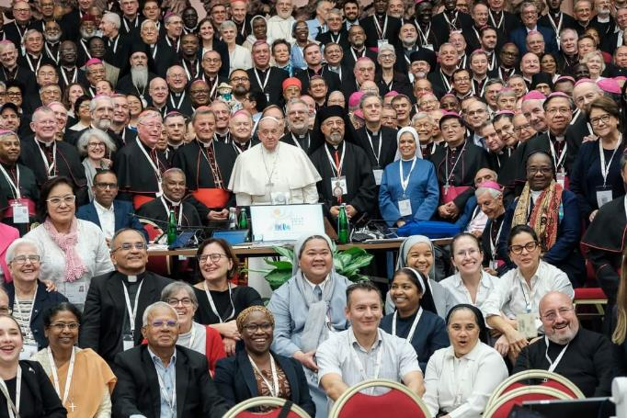
The transformative experience of the synod
The core notion of the « exchange of gifts »
Notes:
For ecumenism : the formula “exchange of gifts” is a technical expression qualifying an ecumenical attitude which recognizes other churches as full partners towards visible unity.
For Synodality in the IL + FD : The notion of the exchange of gifts between local churches
Sharing spiritual and theological traditions
Learning from different ecclesial practices
Mutual enrichment through diverse perspectives
Recognizing the value in different church traditions
FD39. Synodal renewal fosters an appreciation of local contexts as the place where the universal call from God manifests and fulfils itself. It is a call to be part of God’s people, to participate in that Reign of God, which is “righteousness and peace and joy in the Holy Spirit” (Rom 14:17). In this way, different cultures are enabled to grasp the unity that underlies their plurality and become open to the prospect of an exchange of gifts. “The unity of the Church is not uniformity, but an organic blending of legitimate diversities” (NMI 46). There is a variety of ways in which the message of salvation is expressed. This helps avoid reducing this message to a single understanding of the life of the Church and of the theological, liturgical, pastoral and disciplinary forms it takes.
FD41 At the same time, synodality invites - and sometimes challenges – pastors of local Churches, as well as those responsible for leadership in consecrated life and in the movements, to strengthen relationships in order to bring to life an exchange of gifts at the service of the common mission.

Slide 11
Together for Mission
77. The lay faithful, both men and women, should be given greater opportunities for participation, also exploring new forms of service and ministry in response to the pastoral needs of our time in a spirit of collaboration and differentiated co-responsibility. In particular, some concrete needs have emerged from the synodal process. These ought to be responded to according to the various contexts:
  increased participation of laymen and laywomen in Church discernment processes and all phases of decision-making processes (drafting, making and confirming decisions);
  greater access of laymen and laywomen to positions of responsibility in dioceses and ecclesiastical institutions, including seminaries, theological institutes and faculties, more fully enacting existing provisions;
  greater recognition and support for the lives and charisms of consecrated men and women and their employment in positions of ecclesial responsibility;
  a greater number of qualified lay people serving as judges in all canonical processes;
  effective recognition of the dignity and respect for the rights of those who are employed in the Church and its institutions.

Slide 12
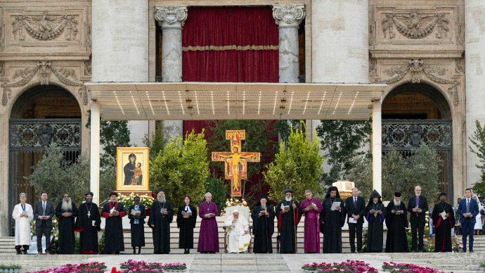
A synod to live unity in diversity as harmony
A new stage for ecumenism
« 137. One of the most significant fruits of the Synod 2021-2024 has been the intensity of ecumenical zeal”
Notes:
“One of the most significant fruits of the Synod 2021-2024 has been the intensity of ecumenical zeal” (FD* 137)
A significant milestone in inter-church relations
Opening new pathways for Christian unity
Deep perspectives on an understanding of communion widened by the discerning experience of the synod
Moving beyond dialogue to concrete collaboration and shared experiences of discernment in common
FD40. We reaffirm the commitment of the Catholic Church to continue and intensify the ecumenical journey with other Christians by virtue of our common Baptism and in response to the call to live together the communion and unity among disciples for which Christ prayed at the Last Supper (cf. Jn 17:20-26). The Assembly welcomes with joy and gratitude the progress in ecumenical relations of the past sixty years, as well as the dialogue documents and declarations expressing the common faith.

Slide 13
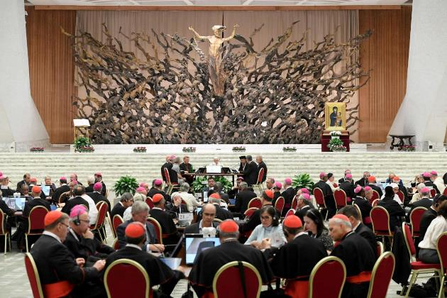
Conclusion
Becoming a synodal Church, our coresponsibility
Notes:
The implementation phase :a new important step
FD 9. The synodal process does not conclude with the end of the current Assembly of the Synod of Bishops but also includes the implementation phase. As members of the Assembly and as synodal missionaries within the communities from which we come, we feel it is our responsibility to promote this process. The local Churches are asked to continue their daily journey with a synodal methodology of consultation and discernment, identifying concrete ways and formation pathways to bring about a tangible synodal conversion in the various ecclesial contexts (parishes, Institutes of consecrated life and Societies of apostolic life, movements of the faithful, dioceses, Episcopal Conferences, groupings of Churches, etc.).
At local level
To give effective application to what is already provided for in current Latin and Eastern law
To proceed with the creative implementation of new forms of ministry and missionary action, experimenting and evaluating experiences. through synodal discernment and within the framework of the possibilities indicated by the Final Document.
At the Roman level
The General Secretariat of the Synod is responsible for accompanying the implementation of the Final Document.
Collaboration with the Dicasteries of the Roman Curia
The synodal process continues beyond the assembly
For the ad limina visit, each bishop will ensure that he reports on: the choices made in the local Church entrusted to him in relation to what is indicated in the Final Document; the difficulties encountered; and the results obtained.
Particular points of attention
Linking territories and networks
The search for unity, the ecclesiology of communion
The ecumenical dimension of the process
The importance of concrete action beyond words

